Slide 1
International Seminar on the National Hydrology Project
William Steen – 2016-11-07

Slide 2
KISTERS at a glance
The KISTERS Group
A Strong Customer Base
KISTERS AG / DACHS / EUS
KISTERS Österreich GmbH
Europe
KISTERS Schweiz GmbH
KISTERS Nederland B. V.
KISTERS Shanghai Software Development Co., Ltd.
KISTERS Pty Ltd.
Asia & Australia
KISTERS North America, Inc.
HyQuest Solutions Pty Ltd.
America
KISTERS France S.A.S. /
RHEA SA
HyQuest Solutions (NZ) Ltd.
KISTERS Ibérica s.l.
South Africa
Markets & Software Products
Corporate Figures
Digital
solutions
Key Figures | 2015
Number of Permanent Employees | > 500
Number of Subsidiaries | 13
Energy management
Energy
Water
Largeformat
Hardware
2D-/3D
Viewer
Environ-mental
Consulting
Hardware.
Software.
Monitoring
Logistics &
Aviation
Engineering Services
Air
Monitoring
Air quality
Environ-mental
Protection
& Safety

Slide 3

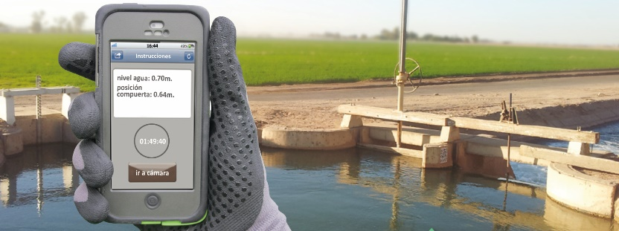
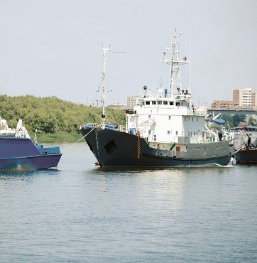
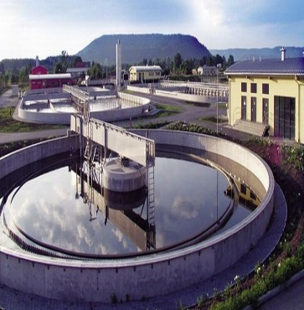
Business Unit Water and its Solution Areas
Hydrology
& Water
Management
Water Quality
&
Ecology
Maritime
Measuring
&
Telemetry
Groundwater
Water
Cloud Services
&
Data-Centres
Urban Drainage
&
Waste Water
Treatment
Meteorology
&
Climatology
Agriculture
&
Irrigation

Slide 4

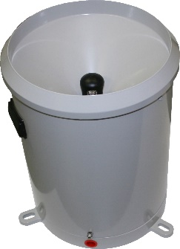
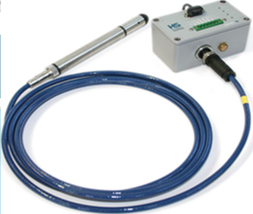

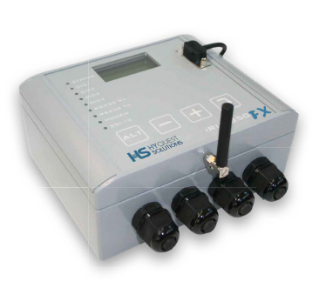
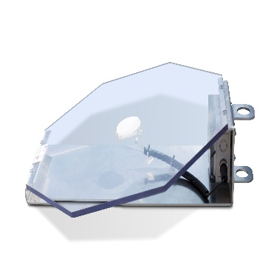
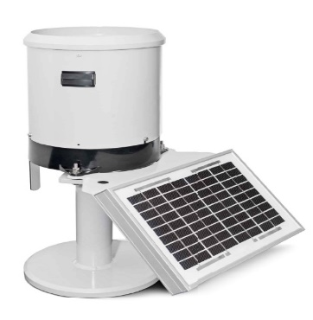
Business Unit Monitoring – Hyquest Solutions
Precision Instrumentation
Hydro-
meterology
SMART
Sensors
Water Level
Monitoring
Data Loggers
Sensor
Development
Monitoring
Innovation:
Hail Sensor
Buy once,
buy it right!

Slide 5
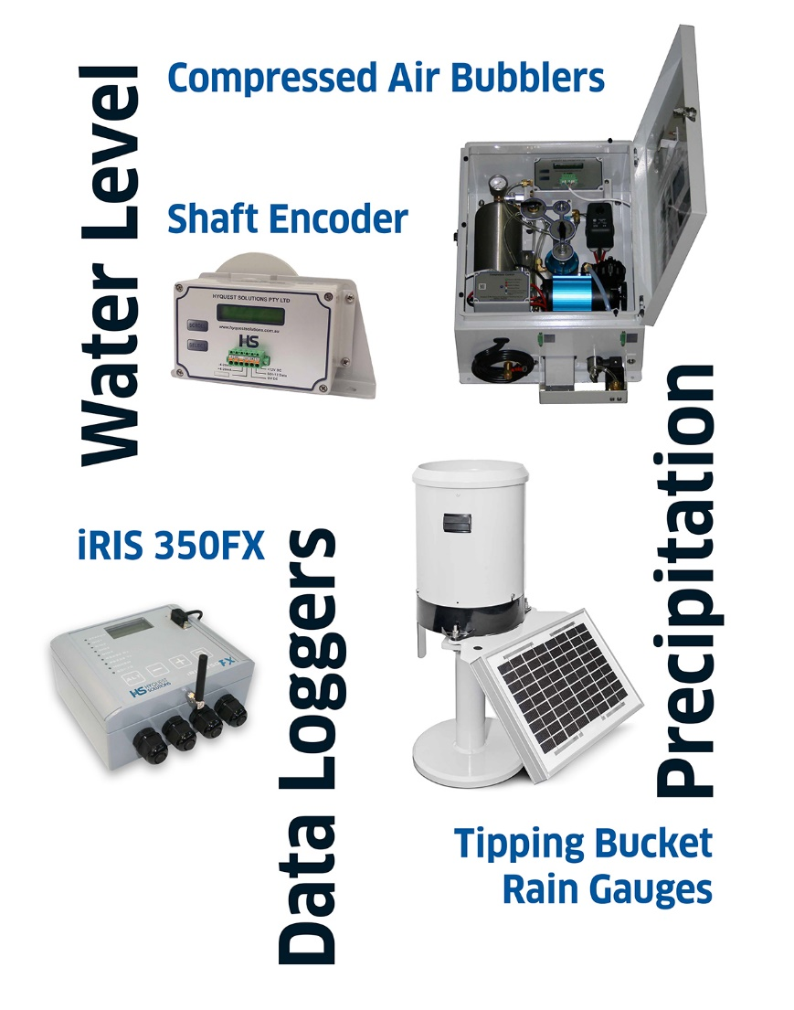
Business Unit Monitoring – Hyquest Solution
Precision Instrumentation, Data Loggers and More …
Hyquest Solutions:
  experienced manufacturer / proven products
  member of the KISTERS Group
Instrumentation & Data Loggers
  robust and stable
  low-power
  good products at fair price – buy it once, buy it right!
Local India Distributor
  Hydrological Services (India)
  Praveen Kumar
  Phone: +91-9977600926
  Fax: +91-731-2553822
  E-Mail: praveenk1476@gmail.com

Slide 6
Business Unit Water and its Solution Areas
Hydrology
& Water
Management
Water Quality
&
Ecology
Maritime
Measuring
&
Telemetry
Groundwater
Water
Cloud Services
&
Data-Centres
Urban Drainage
&
Waste Water
Treatment
Meteorology
&
Climatology
Agriculture
&
Irrigation

Slide 7
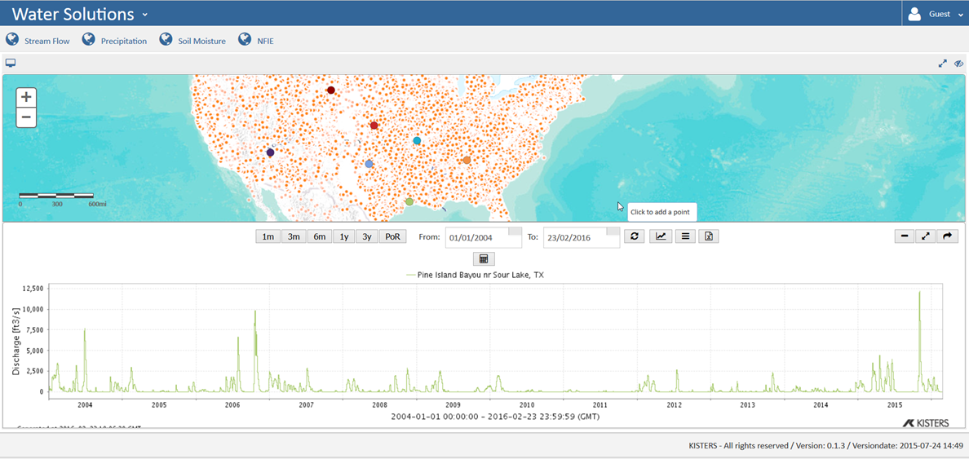

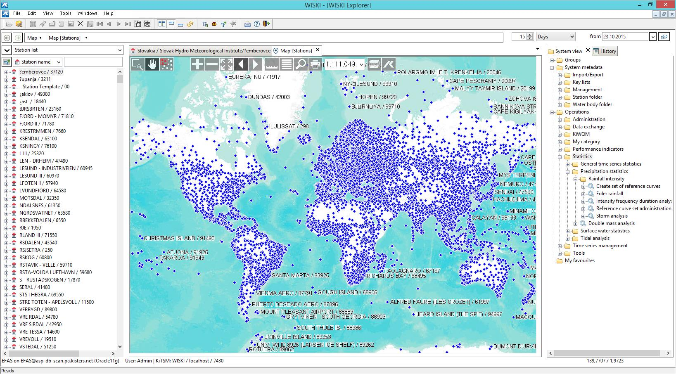


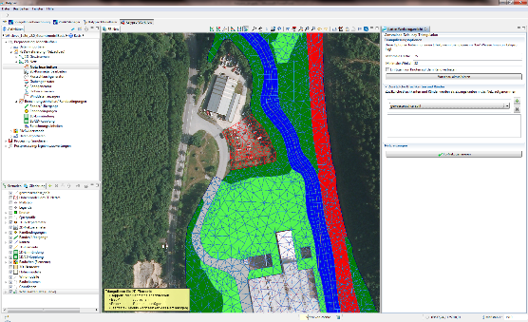

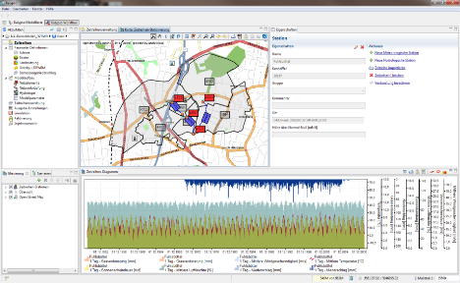





Snapshot – Partners and Cooperations

Slide 8














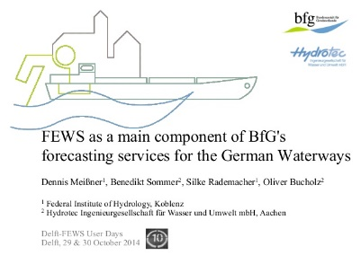












Snapshot – KISTERS Global Client Base

Slide 9
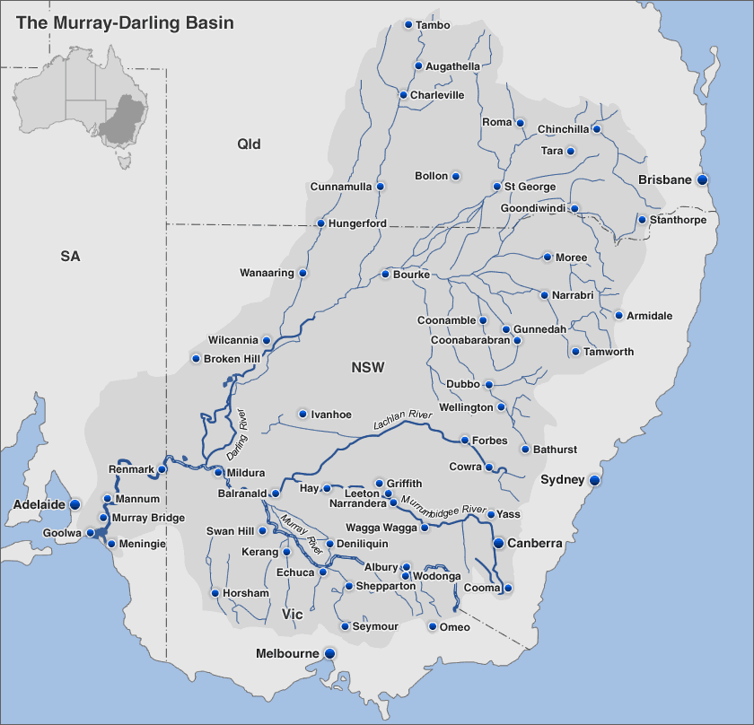
Case Study – Murray Darling Basin Authority
Data Exchange
Operation of the Murray Darling dates back over 100 years.
Data is exchanged between the Commonwealth Government, 4 State Water Agencies and one Territory agency.
Data is transferred via KISTERS data exchange protocols and all data is quality assured and stored within KISTERS water solution.
Data is feed into various models, such as SOURCE, for run of river operations.
MDBA have been utilising KISTERS solutions for over 26 years.

Slide 10
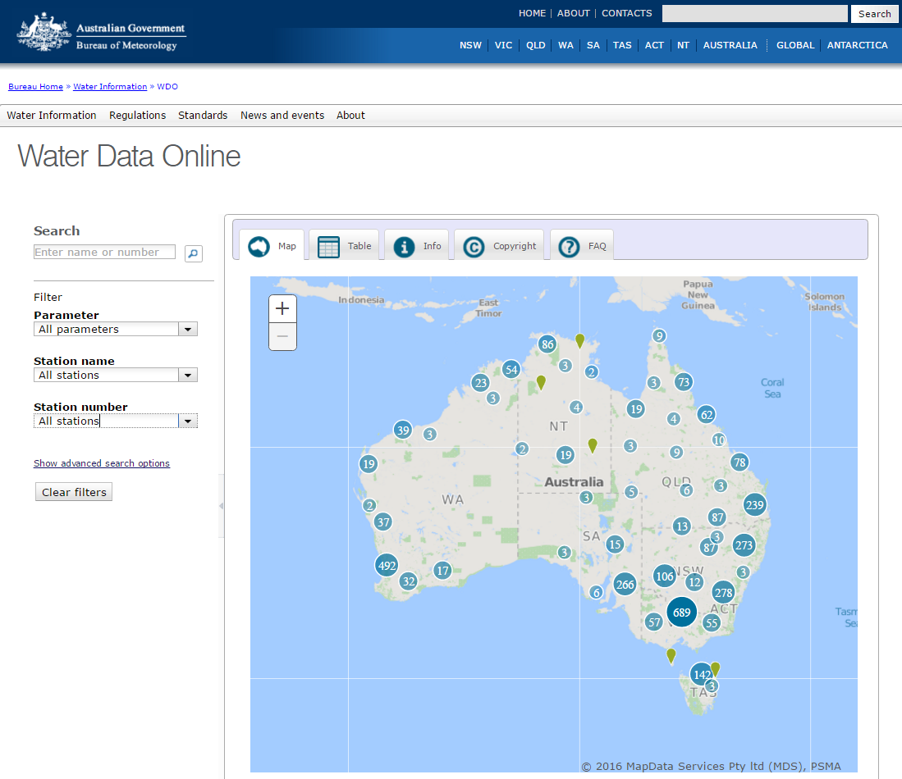
Case Study – Australian Bureau of Meteorology
Australian National Water Information System [AWRIS].
The Water Act 2007 gives the Bureau of Meteorology water information powers and functions:
collecting, holding, managing, interpreting and disseminating Australia's water information;
providing regular reports on the status of Australia's water resources and patterns of usage of those resources;
providing regular forecasts on the future availability of Australia's water resources; and,
compiling and maintaining water accounts for Australia, including a National Water Account.
http://www.bom.gov.au/waterdata/

Slide 11
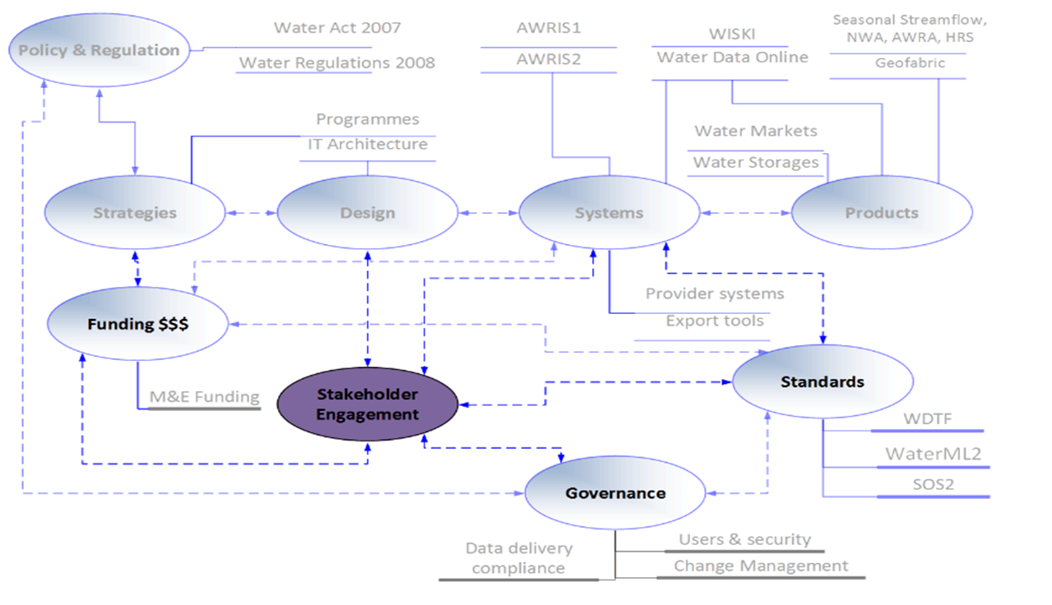
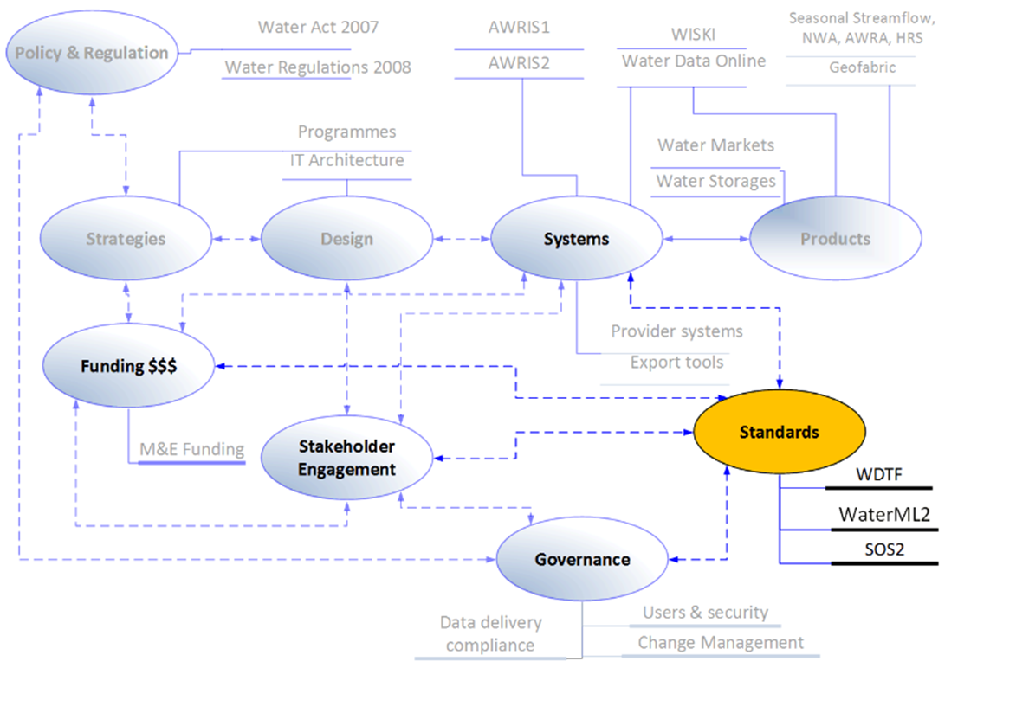
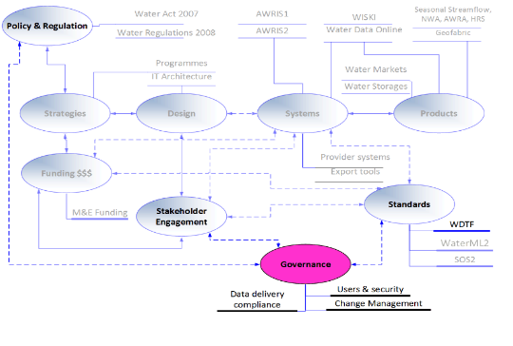
Case Study – Australian Bureau of Meteorology
Australian National Water Information System [AWRIS].
The Problems
Water Information in Australia is collected and reported by more than 200 organisations across Australia.
This diversity of collection and reporting methods made it difficult to collate the information and form an integrated view of Australia's Water Resources.
The work of developing a National Hydrological Database would require a high level of collaboration between stakeholders.
The Solutions
A National Water Data Transfer Format (WDTF) was developed and distributed with the assistance of KISTERS.
WDTF is central to the national harmonisation story – it allows disparate data sources to flow through one funnel into the National Hydrological Database
An “expert panel” from representatives of the major stakeholders assisted in streamlining the data exchange. KISTERS are members of the “expert panel”

Slide 12
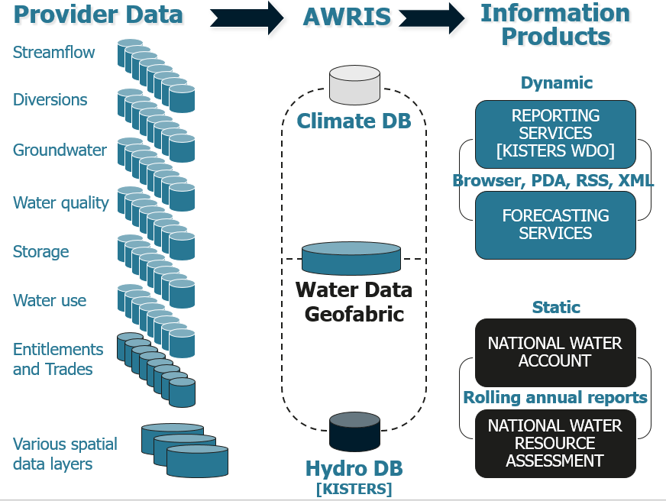
Case Study – Australian Bureau of Meteorology
KISTERS Water Solutions Responsibility

Slide 13
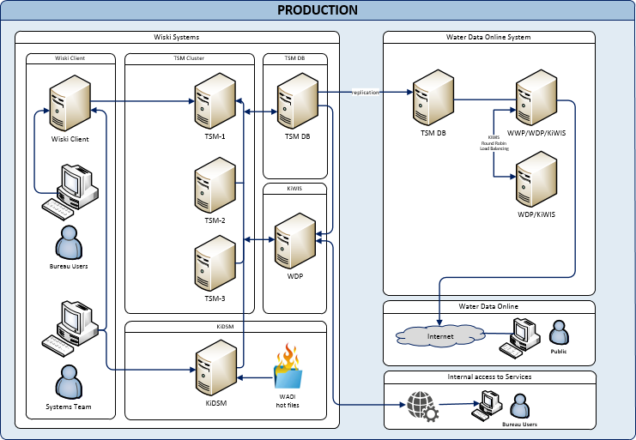
Case Study – Australian Bureau of Meteorology
Australian National Water Information System [AWRIS].
As at the end of 2015;
Over 200 agencies delivering data
120,000 Sites
28,052 Stations
16,000 Parameters
260,000 Time Series
Over 17 Billion Observations
Data is provided from approximately 80% of Australia's surface water stations
AWRIS
WADI
KISTERS
KISTERS
KiDSM
KISTERS Solution
Water Data Online
{KISTERS]

Slide 14
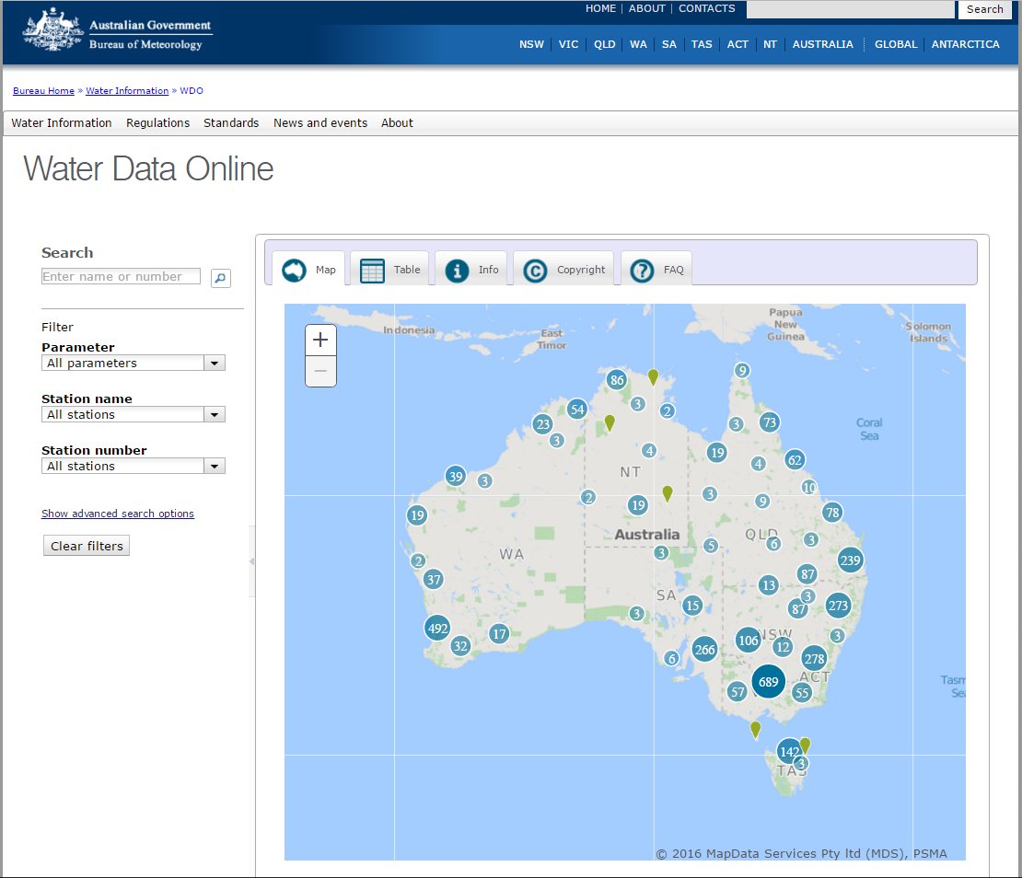
Case Study – Australian Bureau of Meteorology
Australian National Water Information System [AWRIS] – Water Data Online [WDO]
Functions of WDO, the Bureau's online portal to water data:
Map with filters and search;
Time series explorer;
Ratings and gaugings;
Data analysis and statistical reports; and,
Data downloads.
~ 3,500 surface water monitoring stations are available.
KISTERS provides the technology for WDO
http://www.bom.gov.au/waterdata/

Slide 15

Technology

Slide 16


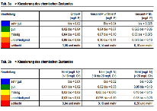

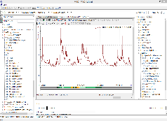
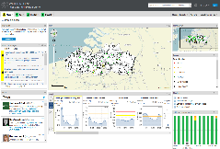
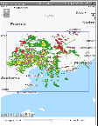










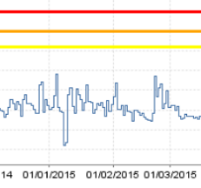
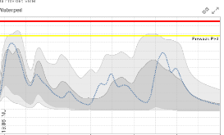


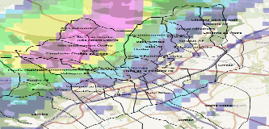
KISTERS Technology Stack
Bringing water data management onto the next level
Desktop
Desktop
Browser
Specialists
Government, Authorities,
Flood centers,
Power plant operators
Consumers
Private public
Engineers, Industry,
Politics
Interfaces
Open standards, Industry standards
Interfaces
Open standards, Industry standards
Calculations
Time series statistics
Polygons statistics
Raster to point calculations
Load calculations
Products
Water quality reports, Year books, Extreme-
value statistics, Retention periods, Base flow,
Water quality maps, Alarm maps, Forecasts
Meta data
Time series data
Ensemble data
Raster data/“Gridded Data”
Samplings
Observations

Slide 17
Summary
Designing of a National Hydrological Database
Your Requirements;
A company with a proven track record.
A company that has the expertise and experience to undertake the design, development and implementation of both a national and state data management system.
A good system relies on good quality data and data collection instrumentation.
KISTERS;
Nearly 30 years proven track record.
Undertaken national systems in Australia, South Africa, UK, etc. Global systems for Global Runoff Data Centre, European Flood Awareness System, World Water Online etc.
KISTERS subsidiary HYQUEST SOLUTION manufacture and sell world wide high quality hydrometric instrumentation, data loggers and telemetry software
From Software Shop to a Full Solution Provider
KISTERS & the Australian Water Partnerships: Support to all of Your Business Processes

Slide 18





From Software Shop to a Full Solution Provider
KISTERS & Partners: Support to all of Your Business Processes
Sensors
Telemetry
Analysis
Reporting
Publication
Logger
Data
Alarming
Modelling
Forecasts
Mobile Apps
GIS-Integration
Solution area specific technical services
IT-Services
IT-Consulting
KISTERS Data Centre

Slide 19
Thank You William Steen General Manager KISTERS Pty Ltd Australia | Email: William.steen@kisters.com.au Phone: +61 2 6154 5210 Address: Unit 4A, 24 Mahony Court Weston Creek, ACT 2611, Australia Web: www.kisters.com.au
"Water is the driving force of all nature"
Leonardo Da Vinci, 1452-1519

